Slide 1
Leveraging High-Performance Computing for
Heart Disease Prediction
20301118 Shouvik Banerjee
20301069 Arian Wazed

Slide 2
Table of contents
1.Introduction
2.Dataset Description
3.Dataset Preprocessing
4.Conclusion

Slide 3
1.Introduction
Heart disease poses significant health challenges, necessitating accurate prediction for timely intervention. Leveraging High-Performance Computing (HPC) in tandem with Machine Learning (ML) algorithms offers a promising avenue for enhancing predictive accuracy. This study conducts a comparative analysis of K-Nearest Neighbors (KNN), Naive Bayes, Logistic Regression, and Decision Trees, using biological parameters like cholesterol levels, blood pressure, sex, and age for heart disease prediction. By evaluating the efficacy of these algorithms, we aim to identify the most effective approach, contributing to advancements in proactive healthcare interventions and precision medicine.

Slide 4
2.Dataset Description
The dataset contains 303 rows and 14 columns, with each row representing a data point and each column a feature. It consists of 13 predictors and one target variable, forming a binary classification problem. Features include quantitative aspects like age, blood pressure, cholesterol levels, and categorical attributes such as sex and chest pain type. Correlations between features are visualized through a heatmap matrix. The dataset shows class imbalance, addressed by imputing missing values and using algorithms tailored for imbalanced data to improve model performance. Evaluation metrics like F1-score, precision, and recall ensure fair representation of all classes.

Slide 5
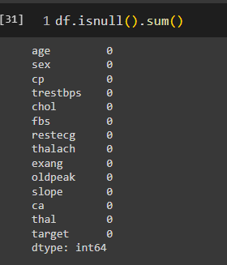
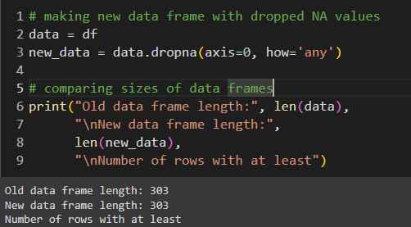
3. Dataset Preprocessing:
Faults: In the dataset there are some null values which we imputed later.
Solutions: Identified the null values and removed the row which contained Null values.

Slide 6
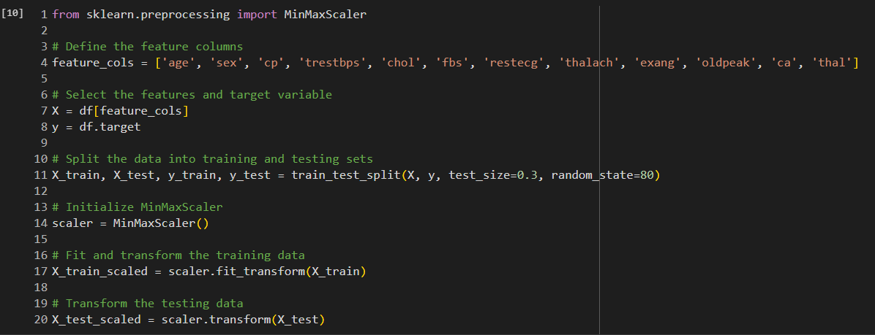
4. Feature Scaling :
MinMaxScaler is useful when the data has a bounded range.Scaling these values using MinMaxScaler ensures that the values are within a fixed range and contributes equally to the analysis. In the dataset, some of the values were outliers that's why it's needed.

Slide 7
5. Dataset Splitting:
The dataset which has been used, the test size is 0.3 So, the training set ratio is 70%, testing set ratio 30% and random_state is 80.

Slide 8
Conclusion
In summary, this study employed advanced techniques to predict heart disease accurately. By meticulously preprocessing and scaling features, we established a strong basis for prediction. Utilizing a carefully preprocessed dataset, our aim was to develop a model aiding in early detection and prevention. Going forward, employing advanced ML algorithms on this prepared dataset could improve diagnostic accuracy and patient outcomes. This research highlights the importance of sophisticated analytics in healthcare, particularly for addressing cardiovascular challenges.

Slide 9
Thank You

